Slide 1


Load balancer in software defined network
Netclaws:
Brinda Raghunatha Bharadwaj
Chandana Boodanur Shivananda
Deepashree Puttenhalli Vajrappa
Pooja Sreedhar Garla
Sindhu Valasa Reddy
Sourabh Kumar

Slide 2



Introduction
Round Robin Load Balancer
Traffic Based Load Balancer
Performance Analysis
Conclusion

Slide 3







Hi, Good Morning!
I Am Bob, the mechanic
Here is my new service station
Vehicle Service

Slide 4

Am getting lot of money .
Let me expand my branches

Slide 5










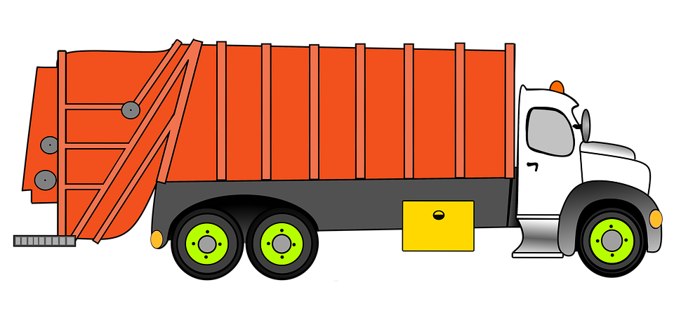

1
3
2

Slide 6








80%

Slide 7
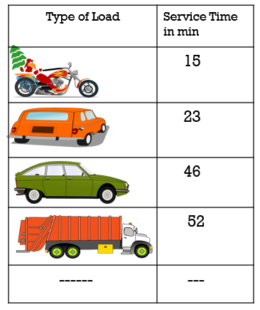

Notes:
size of vehicle,. le

Slide 8
2
1
3
Go to Garage1

Slide 9


2
1
3
Go to Garage 2

Slide 10
2
1
3
Go to Garage 3

Slide 11
2
1
3
Go to Garage 3

Slide 12

2
1
3
Go to Garage 1

Slide 13
2
1
3

Slide 14

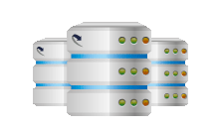

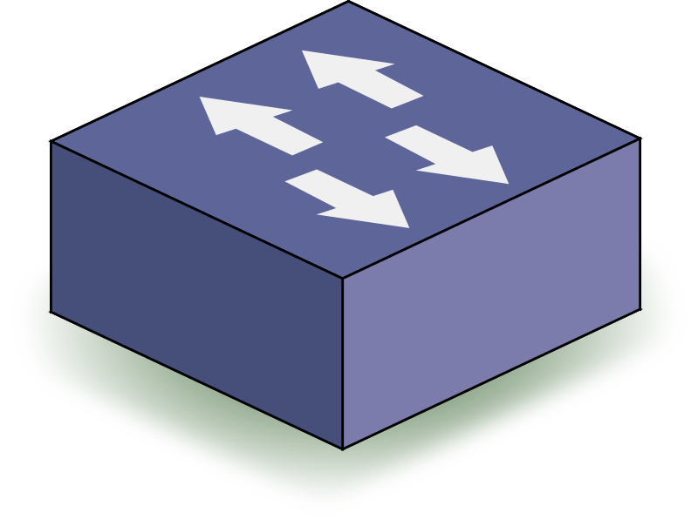
SERVER
SERVER
Load Balancing Controller
SERVER
INCOMING TASKS
SWITCH

Slide 15

SERVER
Controller
SERVER
POX
CONTROL PLANE
DATA PLANE
SERVER
INCOMING TASKS
SWITCH

Slide 16
SERVER
Controller
SERVER
VIP : 10.0.0.5
10.0.0.2
10.0.0.1
SERVER
CLIENT
10.0.0.4
SWITCH
10.0.0.3

Slide 17
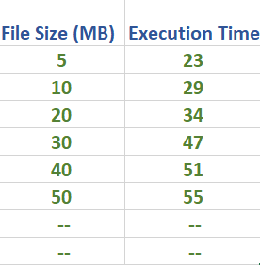

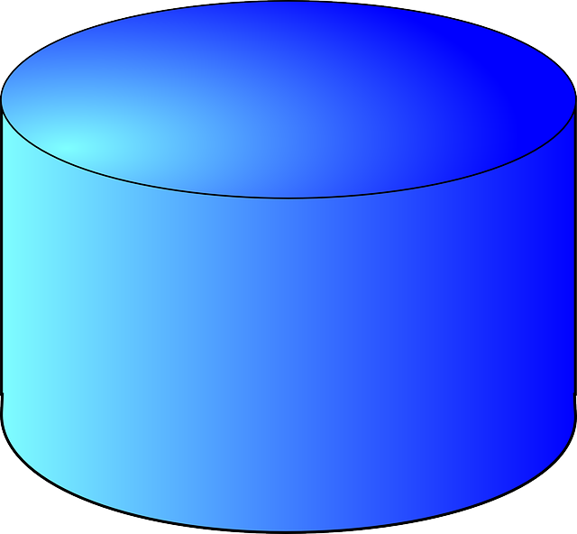
Min(55,23,51)
Server Load
S1 | S2 | S3
55 | 23 | 51
30 47
70
S2
23 + 47 = 70
Server 1
5
30
Client 1
Server 2
30
Client 2
Server 3

Slide 18
Server Load
S1 | S2 | S3
55 | 70 | 51
47
S2
I am done with first job
70 - 23 = 47
Server 1
30
23
23
Client 1
Server 2
Client 2
Server 3

Slide 19
Min(55,47,51)
Server Load
S1 | S2 | S3
55 | 47 | 51
10 29
76
S2
47 + 29 = 76
Server 1
10
10
Client 1
Server 2
Client 2
Server 3

Slide 20
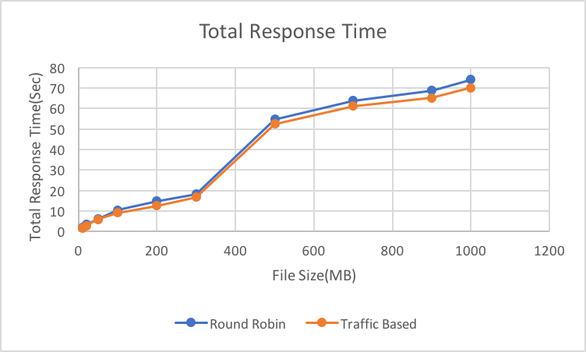

Slide 21
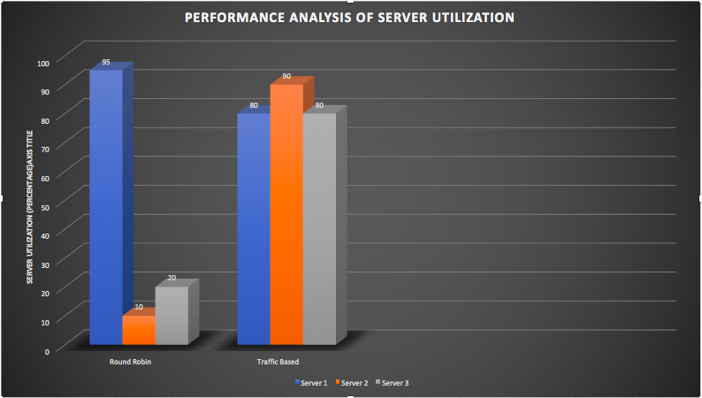

Slide 22

Why not Hardware Load Balancer
Dedicated Hardware
Inflexible
Non Programmable

Slide 23
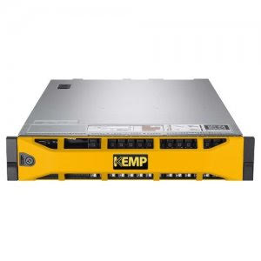
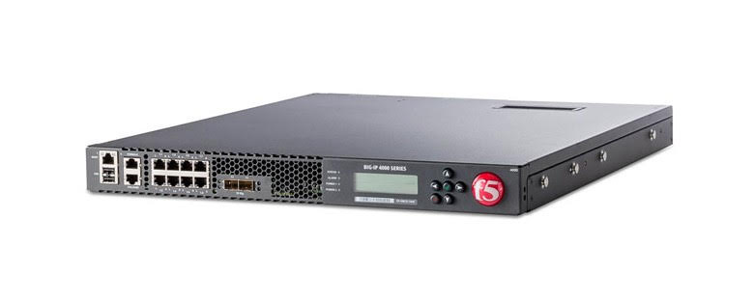
Expensive
KEMP LoadMaster Load Balancer LM-8020M
Higher end Cost – $59,508
Lower end cost - $3,600
F5 networks LTM-4200v
Higher end cost - $60,990
Lower end cost - $3,995

Slide 24
Future Scope
Larger Network
Better Algorithms
Avoid Single Point Failure
IPv6

Slide 25
Project framework
Round Robin Based Load Balancer
01
Traffic Based Load Balancer
02
Performance Analysis
03
Implementation on Deter
04

Slide 26

REFEREnces
Ghaffarinejad, Ashkan, and Violet R. Syrotiuk. "Load balancing in a campus network using software defined networking." In Research and Educational Experiment Workshop (GREE), 2014 Third GENI, pp. 75-76. IEEE, 2014.
Zhou, Yuanhao, Li Ruan, Limin Xiao, and Rui Liu. "A method for load balancing based on software defined network." Advanced Science and Technology Letters 45 (2014): 43-48.
Nunes, Bruno Astuto A., Marc Mendonca, Xuan-Nam Nguyen, Katia Obraczka, and Thierry Turletti. "A survey of software-defined networking: Past, present, and future of programmable networks." IEEE Communications Surveys & Tutorials 16, no. 3 (2014): 1617- 1634.
Kaur et al. "Round-robin based load balancing in software defined networking." In Computing for Sustainable Global Develop. (INDIACom), 2015 2nd Int. Conf. , pp. 2136-2139. IEEE, 2015.
Kaur, Sukhveer, Japinder Singh, and Navtej Singh Ghumman. "Network programmability using POX controller." In ICCCS International Conference on Communication, Computing & Systems, IEEE, no. s 134, p. 138. 2014.

Slide 27

Thank YOU

